Slide 1

UDAAN – Rural Career Guidance Platform
Theme- SDG Goals : 4 (Quality Education), 10 (Reduced
inequality)
Category- Software
Group No - 03
Group Members- Dipika, Pritesh, Arnav, Dhanashree
Guide- Dr. Tejashri Kolhe

Slide 2
Outline
Introduction
Literature Survey
Limitations of existing systems
Problem statement and Objectives
Proposed Methodology
Experimental Setup
Implementation
Results & Analysis
Conclusion and Future work
References

Slide 3

Introduction
Background
Rural students lack structured career guidance
Limited awareness of modern career options
Poor access to professional mentorship
Importance
Career decisions impact long-term growth
Proper guidance reduces unemployment
Supports inclusive education (SDG 4)

Slide 4
Current Challenges
Information gap in rural areas
Confusion in stream selection
Language barriers
Lack of personalized guidance
Motivation (Mapped to SDG 4)
Promote equal educational opportunities
Bridge rural–urban career awareness gap
Provide affordable digital guidance system

Slide 5
Objectives
Develop aptitude-based career guidance system
Suggest stream selection scientifically
Provide AI-based career recommendations
Offer 5-step career roadmap
Support bilingual interface (English + Hindi + Marathi)

Slide 6

Literature Survey
Author & Year | Method Used | Key Result | Limitation
P. S. Deshpande et al. (2024) | AI-driven profile analysis using Machine Learning (ML) | High precision in matching student interest to career paths | High computational overhead for real-time processing
CareerPathAI Research Group (2026) | Combined ML models with milestone-based tracking | Significantly improved student career readiness scores | Limited dataset for unconventional or emerging career fields
S. K. Verma & J. Rao (2022) | Integration of the RIASEC psychological model with XGBoost | Enhanced accuracy in long-term career satisfaction prediction | Does not account for sudden shifts in the global job market
M. Sharma (2025) | Rule-based Expert Systems using JSON knowledge bases | Effective performance even with minimal or incomplete user data | Lacks the learning capability of deep neural networks
Global EdTech Review (2023) | Comparative analysis of web-based MCQ scoring platforms | Effectively identifies core academic strengths in 10th/12th students | Fails to provide detailed post-result guidance or roadmaps
Rural Dev. Initiative (2026) | Mobile-first web portals for information democratization | Successfully bridged the information gap for rural students | High dependency on stable internet connectivity for rich media
H. Gupta et al. (2024) | Random Forest algorithms for automated career prediction | Achieved a 93% accuracy rate in stream classification | Requires large amounts of clean, labeled historical data
V. Nair & B. Joshi (2026) | Interactive Roadmap Visualization & Search Engines | Higher student engagement compared to static counseling | Complex UI can be overwhelming for first-time users
Educational Analytics Lab (2025) | Skill-gap analysis via NLP-based mentoring | Provides a clear path for upskilling based on industry needs | NLP processing may struggle with diverse regional languages
Psychology & Tech Journal (2023) | Standardized Aptitude testing with IQ correlation | Proven reduction in career- choice regret among early users | Relies heavily on the honesty of user-reported data

Slide 7

Techniques Used in Existing Systems
Rule-based aptitude scoring
Questionnaire-based assessment
Basic recommendation systems
Static career databases
Observed Gaps
No rural-focused customization
No bilingual optimization
No structured roadmap

Slide 8
Limitations of existing Systems
Limitations Identified
Urban-centric platforms
Complex UI design
No parental involvement module
No voice support
No integrated roadmap
Limited personalization

Slide 9

Problem statement and Objectives
Problem Statement
Rural students lack accessible, structured, and personalized career guidance due to
limited digital resources, awareness, and mentorship support.
There is a need for a simple, bilingual, aptitude-driven digital platform that guides
students step-by-step in career planning.
Objectives
To develop a rural-focused digital career guidance platform
To conduct an aptitude-based assessment for stream selection
To provide AI-driven career recommendations
To generate a structured 5-step career roadmap
To implement role-based access (Student, Parent, Admin)
To support multilingual interface (English, Hindi & Marathi)
To ensure simple, low-data, user-friendly design

Slide 10
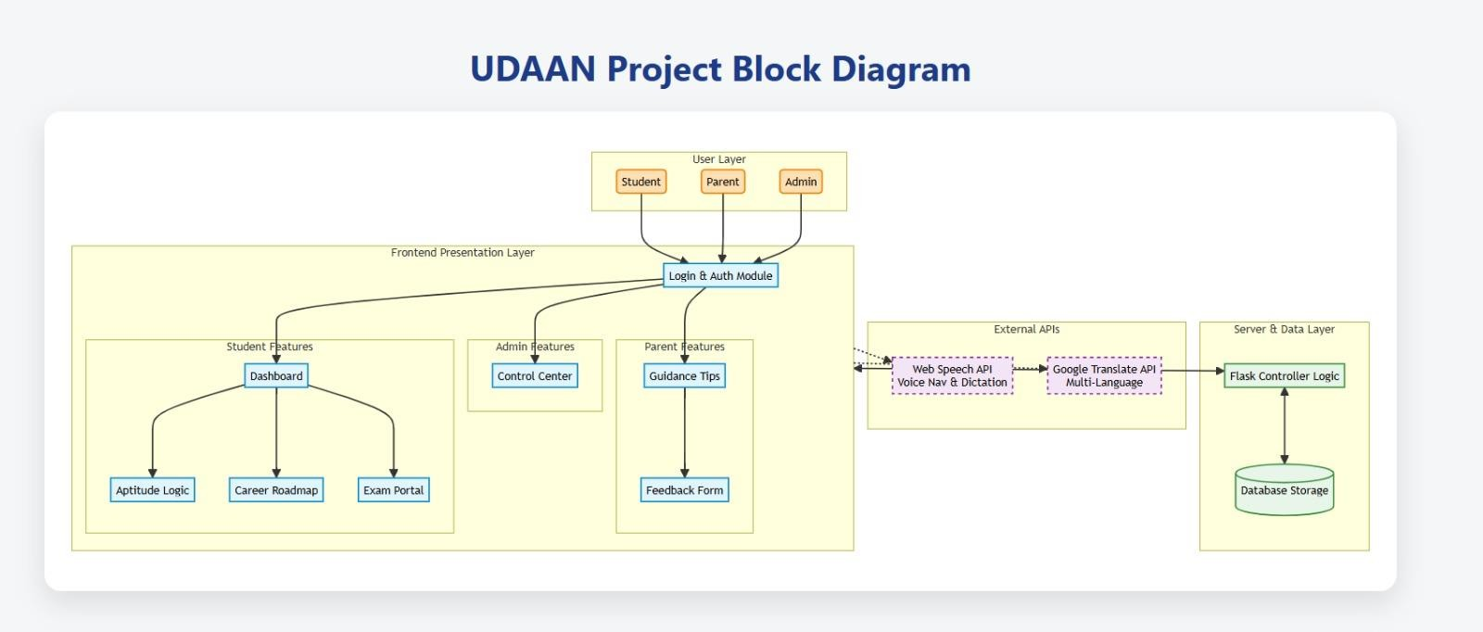
Proposed Methodology

Slide 11
System Architecture Overview
Four Layer Architecture:
User Layer (Student, Parent, Admin)
Frontend Presentation Layer
External API Layer
Server & Data Layer
Ensures modular and scalable design.

Slide 12
Module Description
User Layer
Role-based access control
Frontend Layer
Dashboard
Aptitude Logic
Career Roadmap
Exam Portal
External APIs
Web Speech API
Google Translate API
Server Layer
Flask Controller Logic
Database Storage

Slide 13
Working Methodology
User Login
↓
Aptitude Test
↓
Category-wise Score Calculation
↓
Stream Suggestion
↓
Career Recommendation
↓
5-Step Career Roadmap
Rule-based AI decision logic implemented.

Slide 14
Value Addition / Customization
Rural-focused UI design
English + Hindi + Marathi toggle
Voice navigation support
Parent guidance module
Structured 5-step roadmap
Low-data optimization
Pdf download option

Slide 15

Experimental Setup
Input :
10 Aptitude MCQ Questions
User Profile Data
Software Used :
HTML
CSS
JavaScript
Python Flask
MySQL

Slide 16
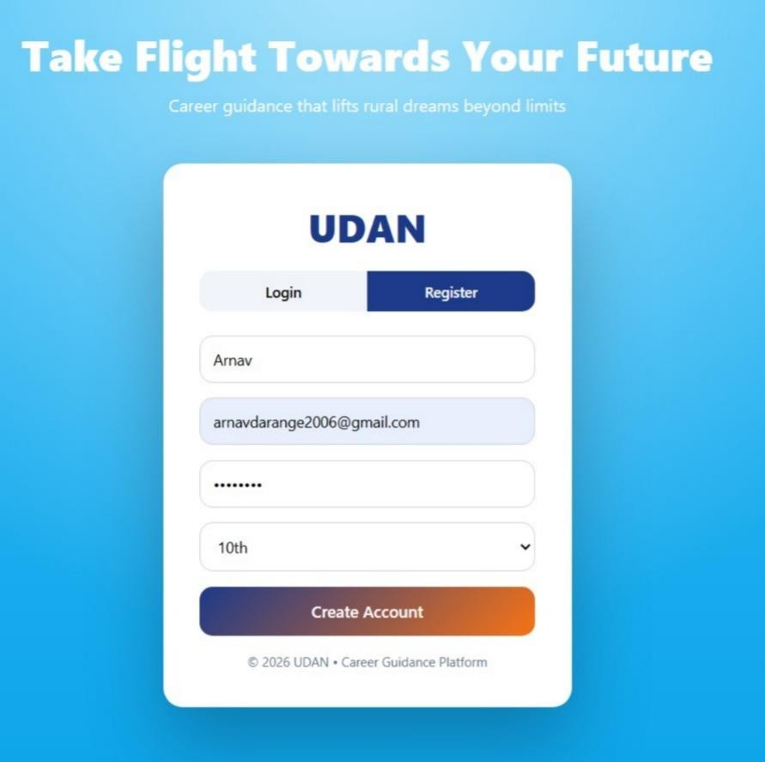
Implementation
Login / Register Page :

Slide 17
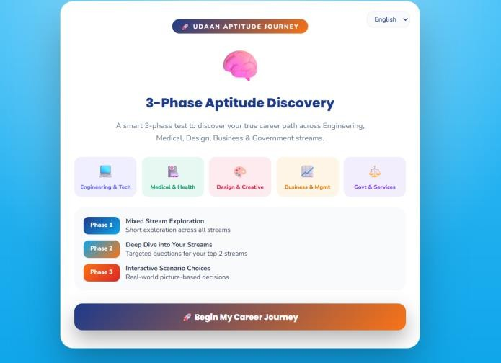
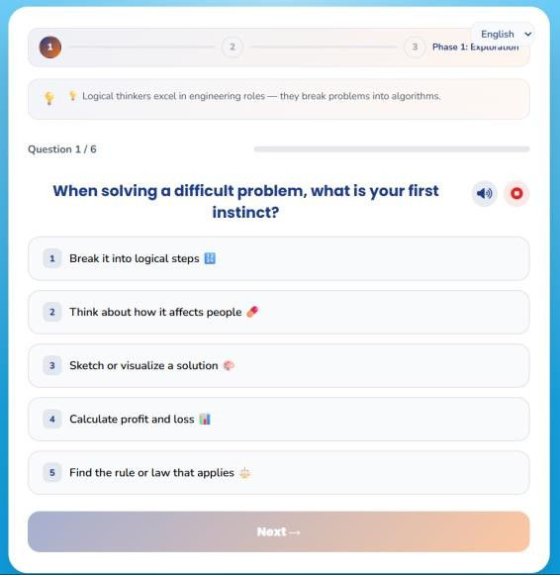
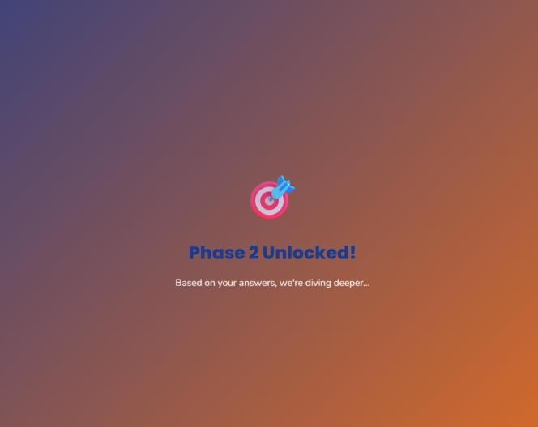
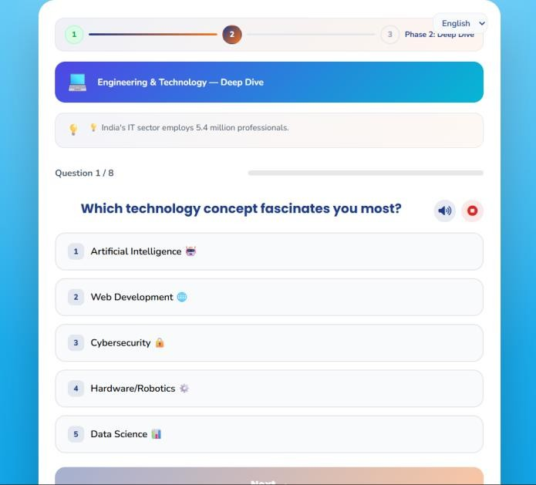
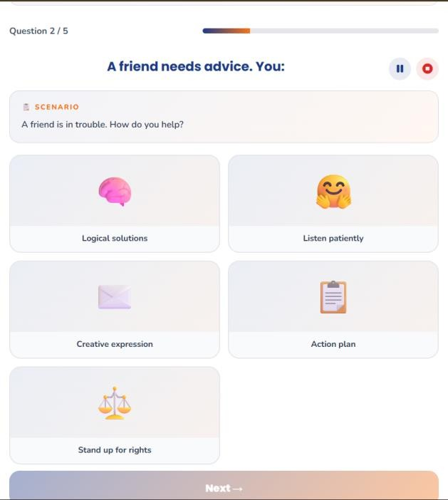

Aptitude Page : 3 Phase Aptitude

Slide 18
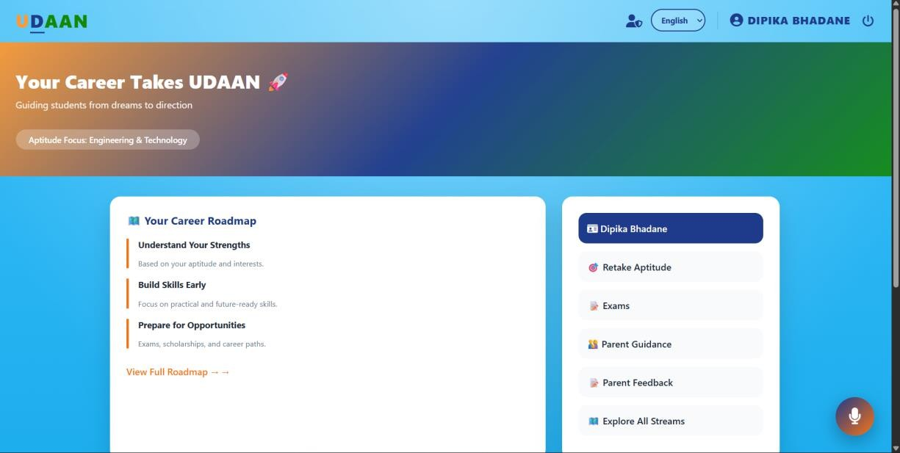
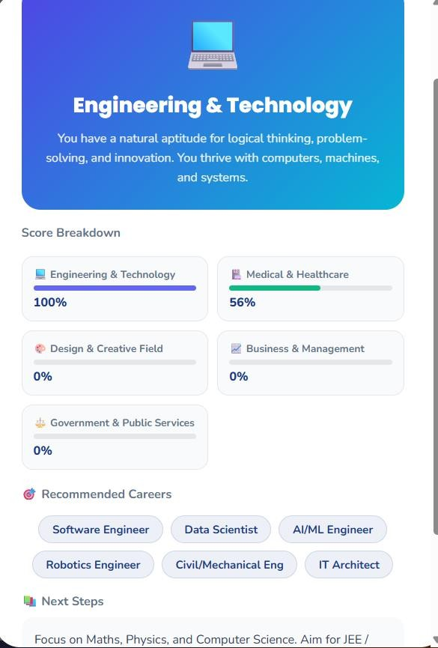
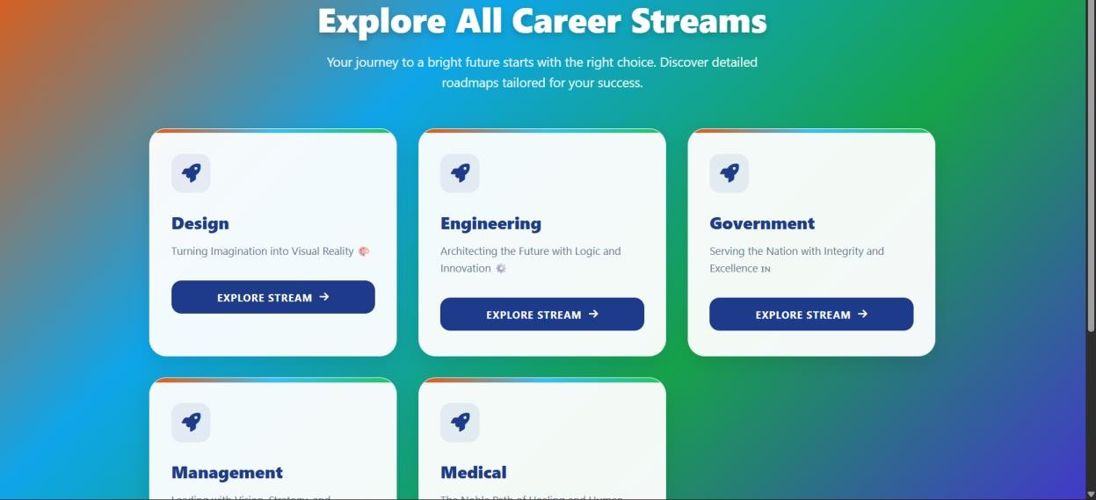
Dashboard:
Aptitude Result:
Explore all stream:

Slide 19
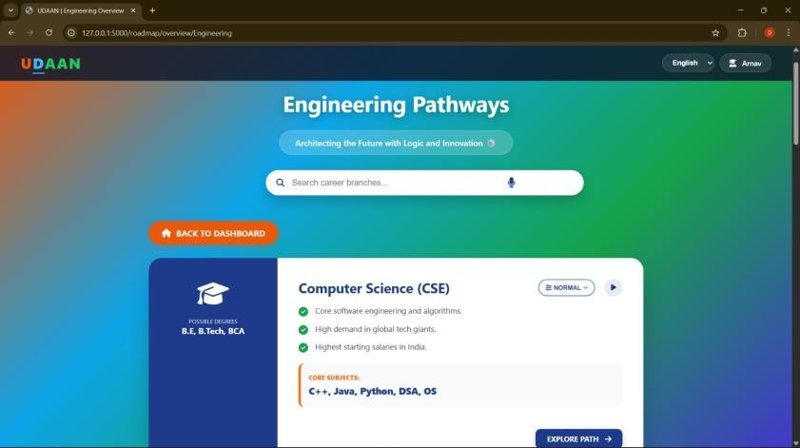
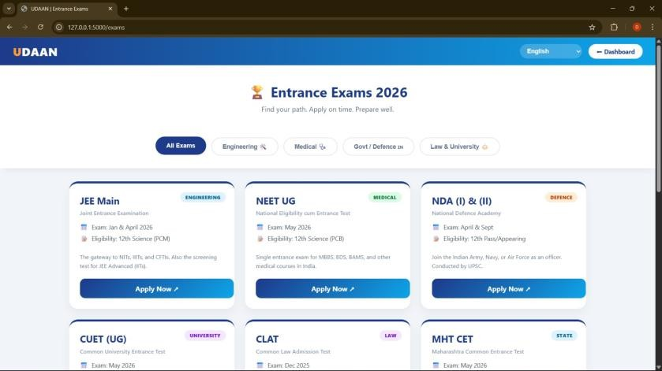
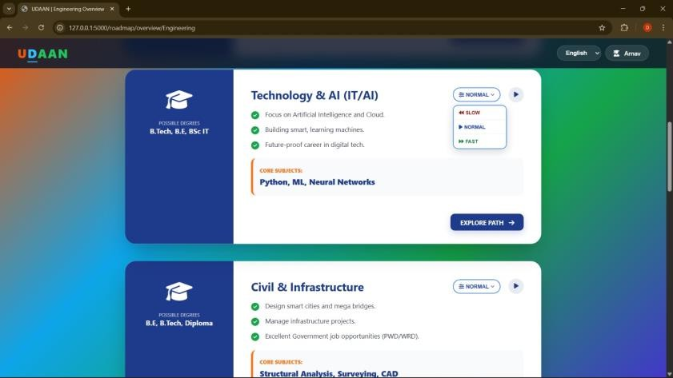
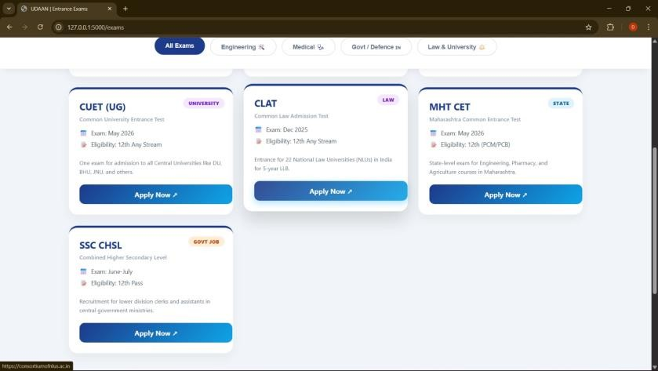
Exams :
Path :

Slide 20
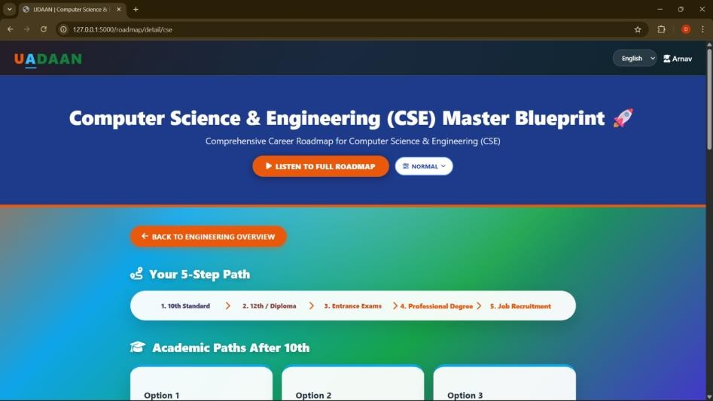
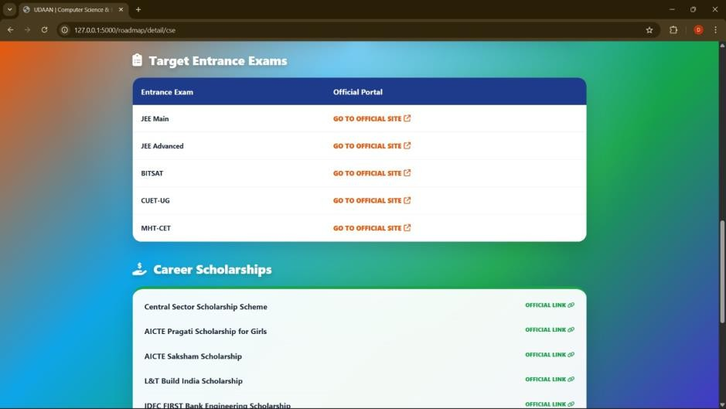
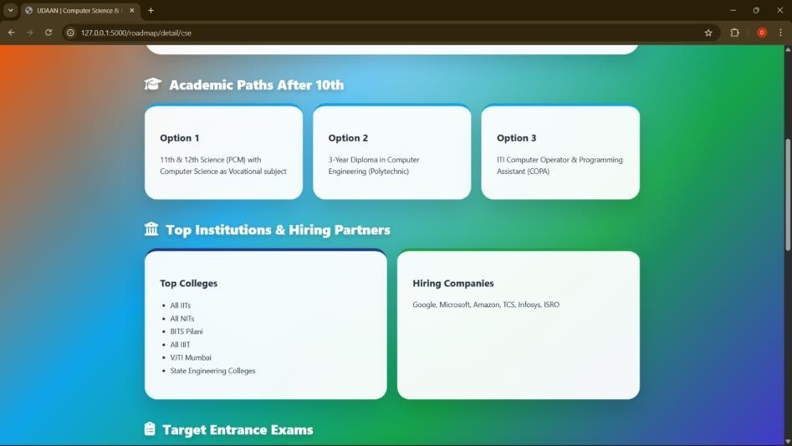
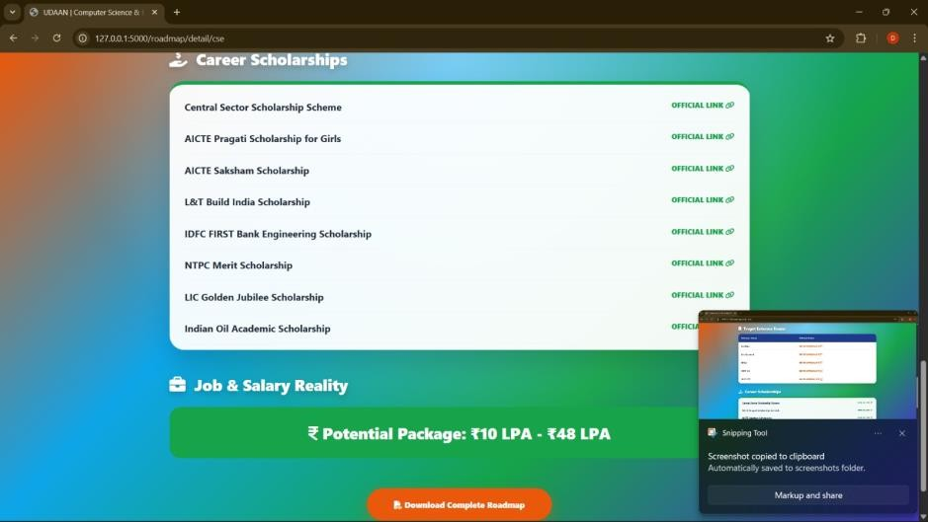
Roadmap :
1
3
2
4

Slide 21
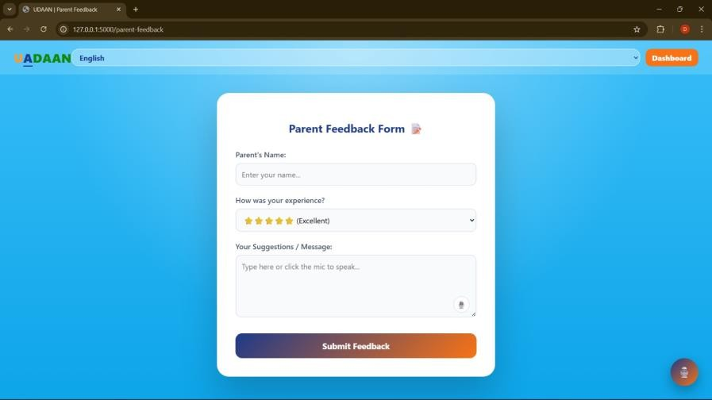
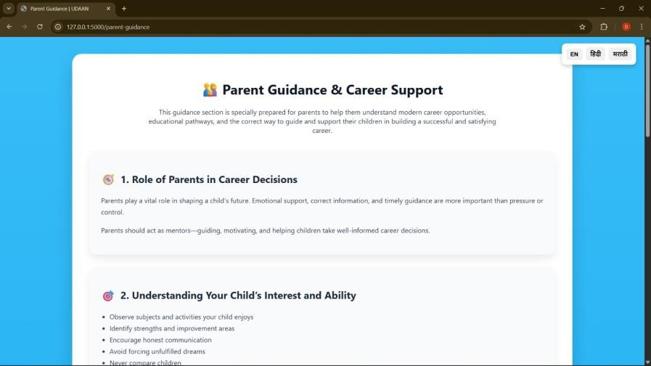
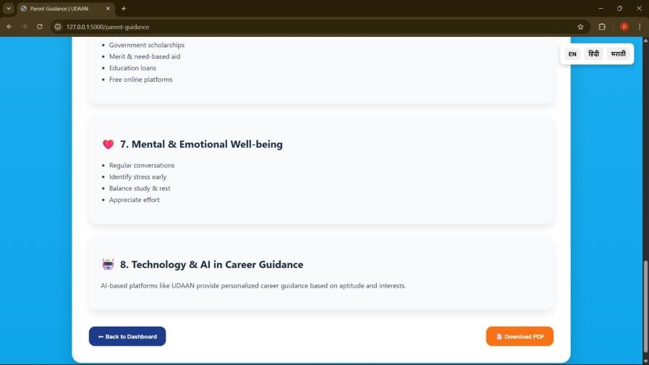
Parent Guidance :
Parent Feedback :

Slide 22
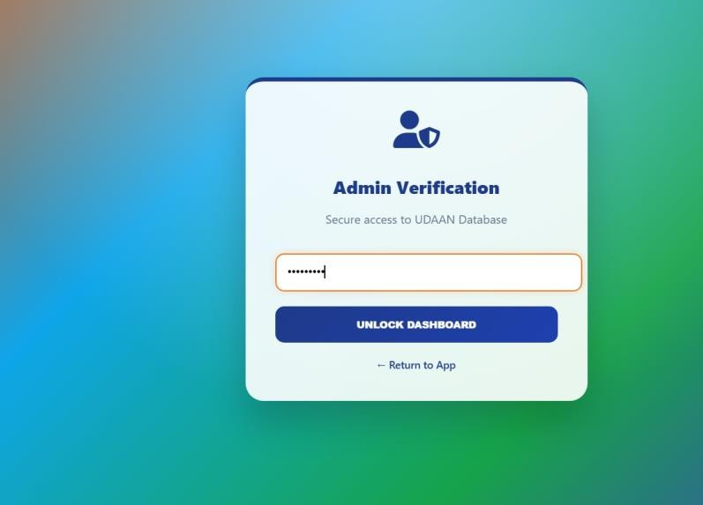
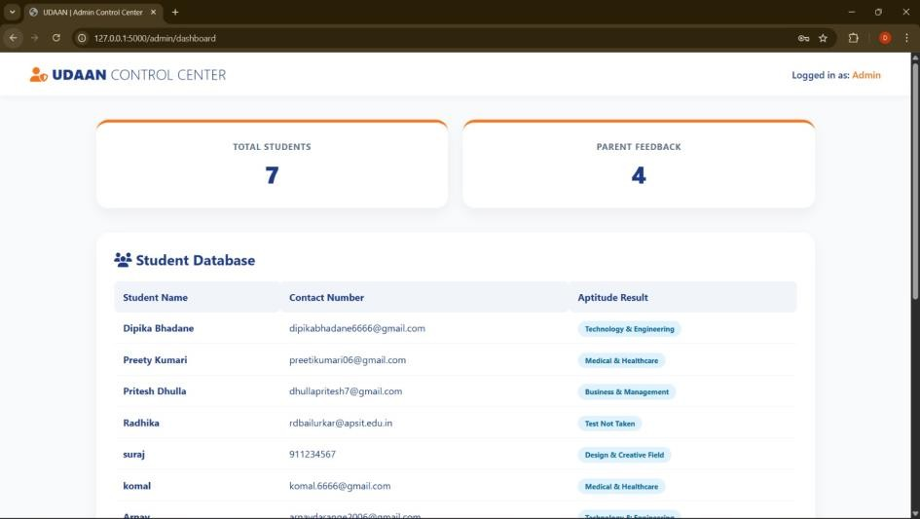
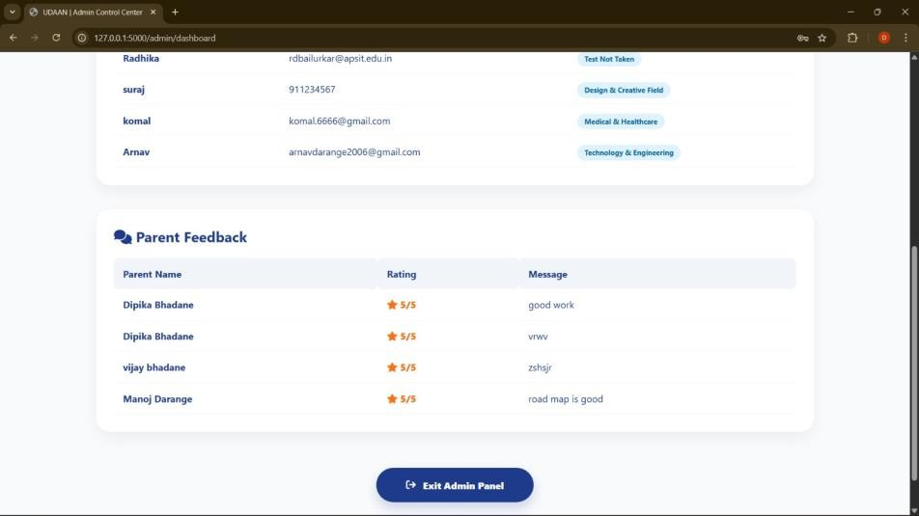
Admin Page :
Admin Login :

Slide 23
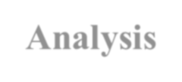

Results & Analysis
Results
Accurate stream classification
Personalized career match percentage
Improved user engagement
Simple and structured navigation
Analysis (Performance Justification)
Rule-based accuracy depends on scoring logic
Clear category-wise decision mechanism
Reduced confusion in stream selection
(If needed, add bar graph of category scoring)

Slide 24




Conclusion and Future work
Conclusion
Developed rural-focused career platform
Achieved SDG 4 mapping
Provided structured guidance system
Implemented modular architecture
Future Work
AI Chatbot integration
Mobile App development
Include all the other professions (careers)
Machine learning-based recommendation
Enabling guidance in other Indian languages too

Slide 25

References
[1] F. Ricci, L. Rokach, and B. Shapira, Recommender Systems Handbook. Boston, MA, USA: Springer, 2011, doi: 10.1007/978-0-387-85820-3.
[2] S. Russell and P. Norvig, Artificial Intelligence: A Modern Approach, 3rd ed.
Upper Saddle River, NJ, USA: Prentice Hall, 2010.
[3] A. K. Suri and R. Bhatnagar, “A Survey of Educational Data Mining,”
International Journal of Computer Applications, vol. 97, no. 13, pp. 33–38, 2014.
[4] United Nations, “Sustainable Development Goal 4: Quality Education,” United
Nations, 2015. [Online].
.

Slide 26

Thank You...!!

